Slide 1

Challenge 1 - Steve's Car Showroom

Slide 2
Introduction
Steve runs a top-end car showroom but his data analyst has just quit and left him without his crucial insights.
Can you analyze the following data to provide him with all the answers he requires?

Slide 3
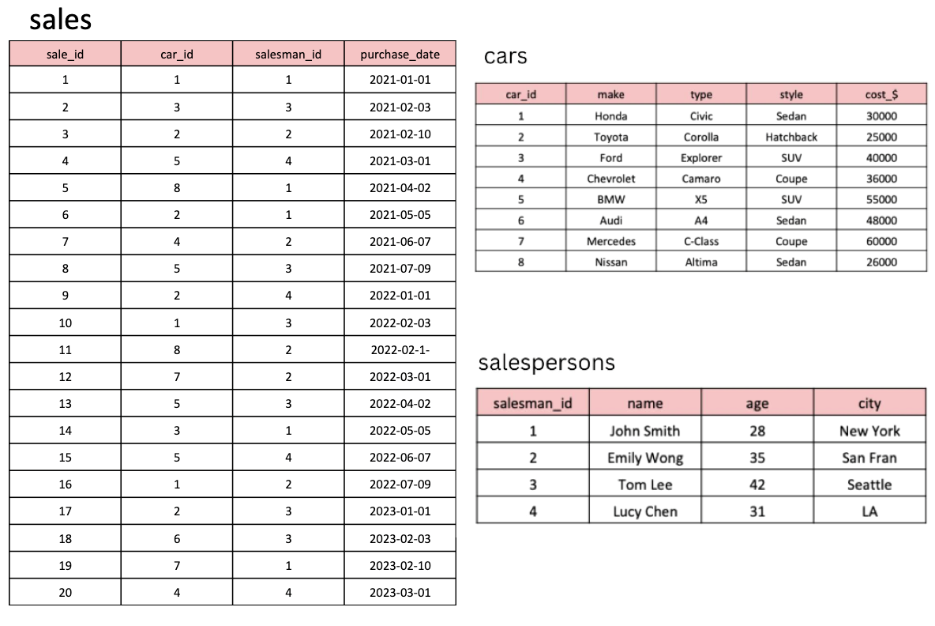
Tables

Slide 4
Create & Insert in Table-cars
CREATE TABLE cars (
car_id INT PRIMARY KEY,
make VARCHAR(50),
type VARCHAR(50),
style VARCHAR(50),
cost_$ INT
);
INSERT INTO cars (car_id, make, type, style, cost_$)
VALUES (1, 'Honda', 'Civic', 'Sedan', 30000),
(2, 'Toyota', 'Corolla', 'Hatchback', 25000),
(3, 'Ford', 'Explorer', 'SUV', 40000),
(4, 'Chevrolet', 'Camaro', 'Coupe', 36000),
(5, 'BMW', 'X5', 'SUV', 55000),
(6, 'Audi', 'A4', 'Sedan', 48000),
(7, 'Mercedes', 'C-Class', 'Coupe', 60000),
(8, 'Nissan', 'Altima', 'Sedan', 26000);

Slide 5
Create & Insert in Table-salespersons
CREATE TABLE salespersons (
salesman_id INT PRIMARY KEY,
name VARCHAR(50),
age INT,
city VARCHAR(50)
);
INSERT INTO salespersons (salesman_id, name, age, city)
VALUES (1, 'John Smith', 28, 'New York'),
(2, 'Emily Wong', 35, 'San Fran'),
(3, 'Tom Lee', 42, 'Seattle'),
(4, 'Lucy Chen', 31, 'LA');

Slide 6
Create & Insert in Table-sales
CREATE TABLE sales (
sale_id INT PRIMARY KEY,
car_id INT,
salesman_id INT,
purchase_date DATE,
FOREIGN KEY (car_id) REFERENCES cars(car_id),
FOREIGN KEY (salesman_id) REFERENCES salespersons(salesman_id)
);
INSERT INTO sales (sale_id, car_id, salesman_id, purchase_date)
VALUES (1, 1, 1, '2021-01-01’), (2, 3, 3, '2021-02-03’),
(3, 2, 2, '2021-02-10’), (4, 5, 4, '2021-03-01'),
(5, 8, 1, '2021-04-02’), (6, 2, 1, '2021-05-05'),
(7, 4, 2, '2021-06-07’), (8, 5, 3, '2021-07-09'),
(9, 2, 4, '2022-01-01’), (10, 1, 3, '2022-02-03'),
(11, 8, 2, '2022-02-10'),(12, 7, 2, '2022-03-01'),
(13, 5, 3, '2022-04-02’), (14, 3, 1, '2022-05-05'),
(15, 5, 4, '2022-06-07’), (16, 1, 2, '2022-07-09'),
(17, 2, 3, '2023-01-01’), (18, 6, 3, '2023-02-03'),
(19, 7, 1, '2023-02-10’), (20, 4, 4, '2023-03-01');

Slide 7
Questions & Answers

Slide 8
1. What are the details of all cars purchased in the year 2022?
select *
from cars c
join sales s on c.car_id=s.car_id
WHERE YEAR(s.purchase_date)=2022;

Slide 9
2. What is the total number of cars sold by each salesperson?
select sp.salesman_id, sp.name, count(s.sale_id) as cars_sold
from salespersons sp join sales s
on sp.salesman_id=s.salesman_id
group by s.salesman_id
order by cars_sold desc;

Slide 10
3. What is the total revenue generated by each salesperson?
select sp.salesman_id, sp.name, sum(c.cost_$) as revenue_generated
from salespersons sp join sales s
on sp.salesman_id=s.salesman_id
join cars c
on s.car_id=c.car_id
group by s.salesman_id
order by revenue_generated desc;

Slide 11
4. What are the details of the cars sold by each salesperson?
select sp.*, c.*
from salespersons sp join sales s
on sp.salesman_id=s.salesman_id
join cars c
on s.car_id=c.car_id;

Slide 12
5. What is the total revenue generated by each car type?
select c.type, sum(c.cost_$) as revenue_generated
from sales s
join cars c
on s.car_id=c.car_id
group by c.type
order by revenue_generated desc;

Slide 13
6. What are the details of the cars sold in the year 2021 by salesperson 'Emily Wong'?
select s.salesman_id, sp.name, c.*
from salespersons sp join sales s
on sp.salesman_id=s.salesman_id
join cars c
on s.car_id=c.car_id
where year(s.purchase_date)=2021 and sp.name='Emily Wong';

Slide 14
7.What is the total revenue generated by the sales of hatchback cars?
select c.style, sum(c.cost_$) as revenue_generated
from sales s
join cars c
on s.car_id=c.car_id
where c.style='Hatchback';

Slide 15
8. What is the total revenue generated by the sales of SUV cars in the year 2022?
select c.style, sum(c.cost_$) as revenue_generated
from sales s
join cars c
on s.car_id=c.car_id
where c.style='SUV' and year(purchase_date)=2022;

Slide 16
9. What is the name and city of the salesperson who sold the most number of cars in the year 2023?
select sp.name, sp.city, count(s.sale_id) as cars_sold
from salespersons sp join sales s
on sp.salesman_id=s.salesman_id
where year(s.purchase_date)=2023
group by s.salesman_id
order by cars_sold desc limit 1;

Slide 17
10. What is the name and age of the salesperson who generated the highest revenue in the year 2022?
select sp.name, sp.age, sum(c.cost_$) as revenue_generated
from salespersons sp join sales s
on sp.salesman_id=s.salesman_id
join cars c
on s.car_id=c.car_id
where year(purchase_date)=2022
group by s.salesman_id
order by revenue_generated desc limit 1;

Slide 18

Thank You!

